Slide 1
Entity Relationship Model
The E-R model is a high level data model it distinguish between basic object called entities and relationship among those object.
The E-R models employ basic concepts,
      Entity sets
      Relationship sets
      Attributes

Slide 2
Entity Sets
Entity:
It is a thing or object in the real world that is distinguishable from other objects.
An entity has a set of properties and the values for some set of properties may uniquely identify an entity.
Ex: Person is an entity and person_id – uniquely identifies that person.
Entity set: An entity set is a set of entity of same type that share same properties or attributes.
Ex: Student - represents the set of all students in the university.
An entity is represented by a set of attributes and each entity has a value for each of its attributes.
Example entity set for student
Student
Roll no | S_name
101 | John
102 | Peter
301 | Saran
405 | Michael

Slide 3
Types of Entity Set
  Strong Entity Set
An entity set that has a primary key is called strong entity set
  Weak Entity Set
An entity set that does not have a primary key is called weak entity set
  Identifying or Owner Entity set
Weak entity set must be associated with another entity set called identifying or owner entity set.
The weak entity set is said to be existence dependent on identifying entity set

Slide 4

Relationship Set
Relationship
Association among several entities.
Relationship set
A relationship set is a of relationships of same type.
It is a mathematical relation on n>=2 entity set.
If E1,E2,……. En are entity sets, then relationship set R is a subset of
where (e1,e2,..en) is a relationship.

Slide 5
Attributes
An attribute of an entity set is a function that maps from the entity set into a domain.
For each attributes, there is a set of permitted value set of that attribute.
Types of attributes:
  Simple and composite
  Single value and multivalued
  Derived
  Descriptive

Slide 6
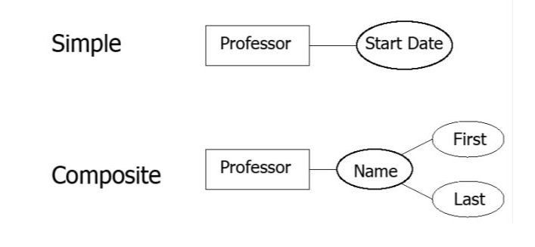
Simple& composite attributes
  Simple attributes
Attributes that cannot be divided into subparts are called simple attributes Ex: S.no is a simple attributes.
  Composite attribute
Attribute that can be divided into subparts is called as composite attributes.

Slide 7
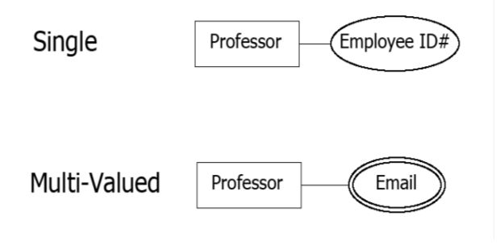
Single valued & multivalued attribute
Single valued attribute
The attribute that have single value for a particular entity is called
single valued attribute.
Ex: student_id – refers to only one student.
  Multivalued attributes
The attribute that has a set of values for a specific entity is called
multivalued attributes.
Ex: phone_number.

Slide 8
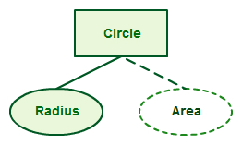
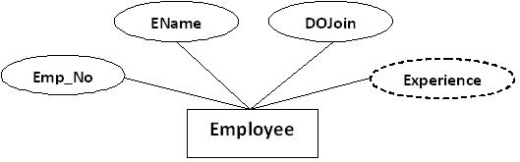
Derived attributes
The value of this type of attribute can be derived from the
values of other related attributes or entities.

Slide 9
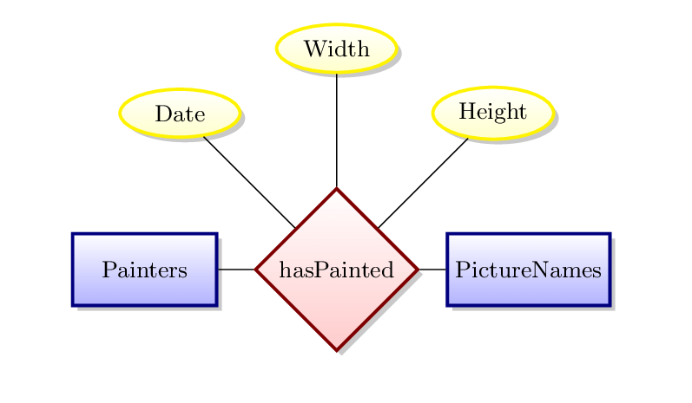
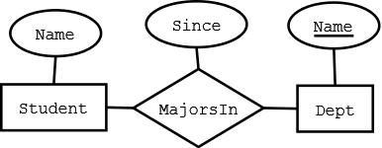
Descriptive attributes
The attribute present in the relationship is called as
descriptive attribute.

Slide 10
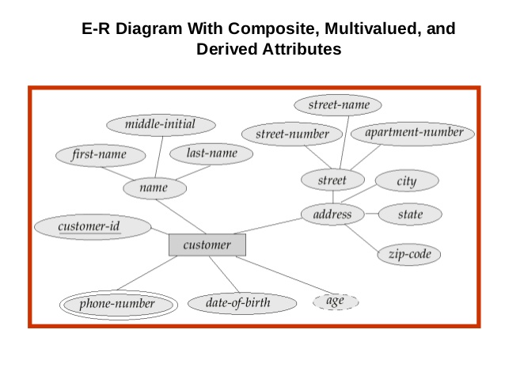
NULL value
The attribute takes a NULL value, when an entity does not have a value for it.
In the above ER diagram,
City, State – Simple Attribute
C_name& address - Composite Attribute Street - Composite Attribute
Customer_ID – Single Valued Attribute
Phone-number - Multi-valued Attribute
Age - Derived Attribute

Slide 11
Constraints
Mapping cardinalities
Participation constraints
keys

Slide 12
  Mapping cardinalities
A mapping cardinality is a data constraint that specifies
how many entities and an entity can be related to in a relationship set.
Types of mapping cardinalities are
    one to one
    one to many
    many to one
    many to many

Slide 13
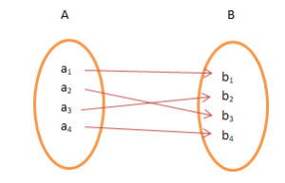
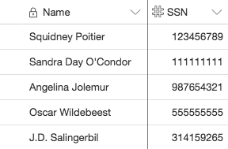
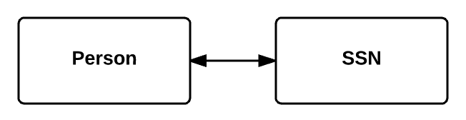
  One-to-One
An entity in A is related to at most one entity in B, and an entity in B is related to At most one entity in A.

Slide 14
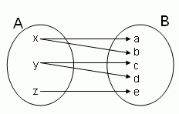
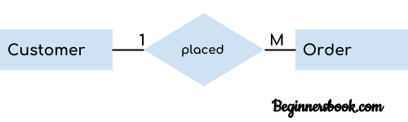
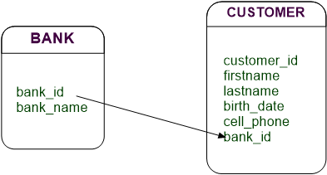
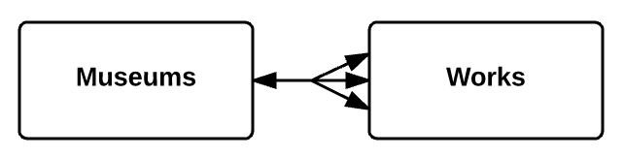
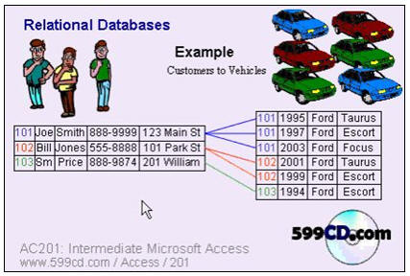
  One-to-Many
An entity in A is related to any number of entities in B, but an entity in B is related to at most one entity in A.

Slide 15
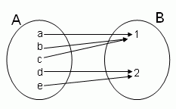
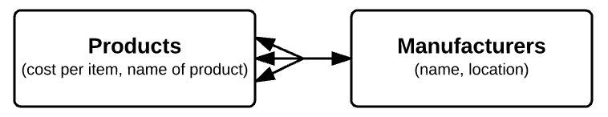
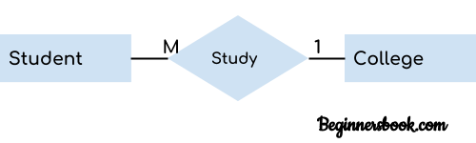
    Many-to-One
An entity in A is related to at most one entity in B, but an
entity in B is related to any number of entities in A.

Slide 16
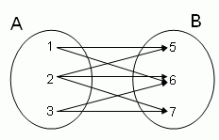
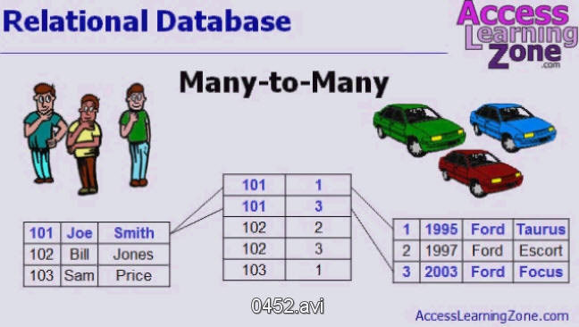
  Many-to-Many
An entity in A is related to any number of entities in B, but an
entity in B is related to any number of entities in A.

Slide 17
Participation Constraints
  Total Participation
  Partial Participation

Slide 18
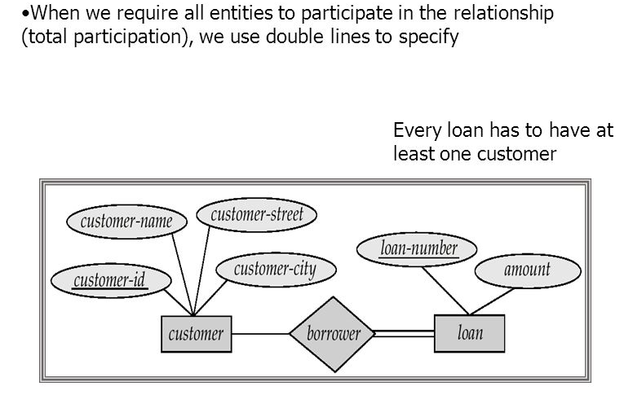
Total Participation:
The participation of an entity set E in a relationship set R is said to
be total , if every entity in E participates in atleast one relationship in R.

Slide 19
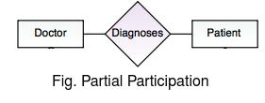
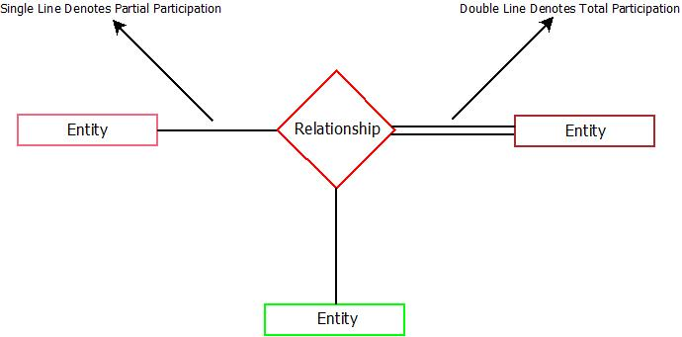
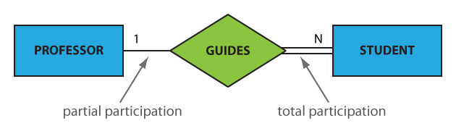
Partial Participation:
If only some entities in E participate in relationship in R, then the participation of entity E in relationship R is said to be partial

Slide 20
Keys
It is the value of the attribute value of an entity such that they can uniquely identify the entity.
  Super key
  Candidate key
  Primary key
  Foreign key
  Referential integrity

Slide 21
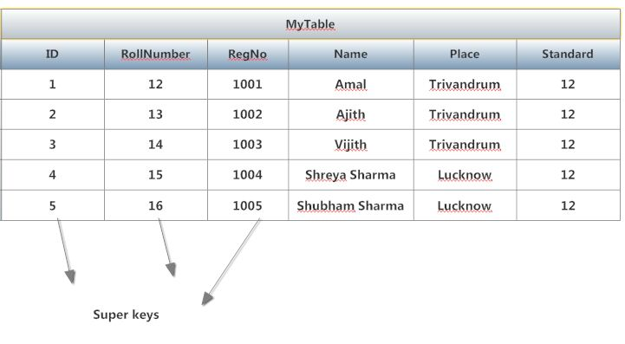
Super key
It is a set of one or more attributes, that taken collectively
allows us identify uniquely a tuple in the relation.
Example: Reg_no of students entity ie a superkey.

Slide 22
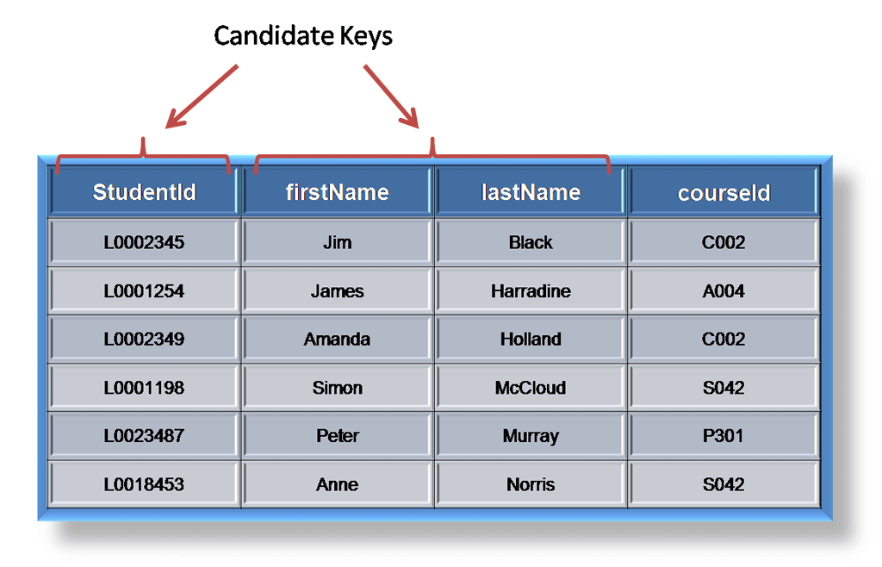
Candidate key
Minimal superkeys are called candidate key.
Candidate key – subset is not a super key.
Ex: name & dept_name of instructor relation forms a candidate key.

Slide 23
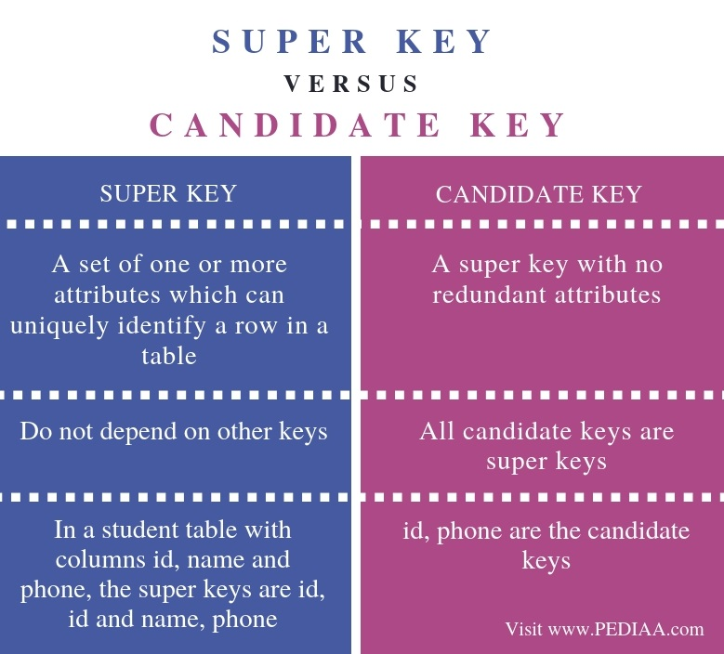

Slide 24
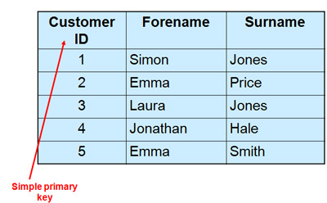
Primary key
It is a candidate key which acts as a principal means of identifying
tuples within a relation.

Slide 25
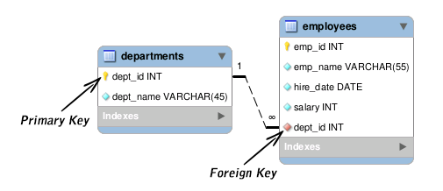
Foreign key
A relation R1 may include among its attributes, the primary key
of another relation R2.
This attribute is called foreign key from R1 referencing R2.
R1 – referencing relation
R2 – referenced relation
R2
R1

Slide 26
Referential integrity
It requires that the values appearing in specified attribute of any
tuple in referencing relation also appear in specified attributes of atleast
one tuple in referenced relation.

